Slide 1
Low-Power 4-Bit ALU using Adiabatic Logic with FINFET Technology
Group No:
2310040049-Navya
2310040064-Gayathri
2310040072-Akshaya

Slide 2
OBJECTIVES:
Reduce power using adiabatic logic
Use FinFET technology for leakage control
Implement 4-bit ALU with arithmetic and logical operations
Perform simulation and analysis

Slide 3

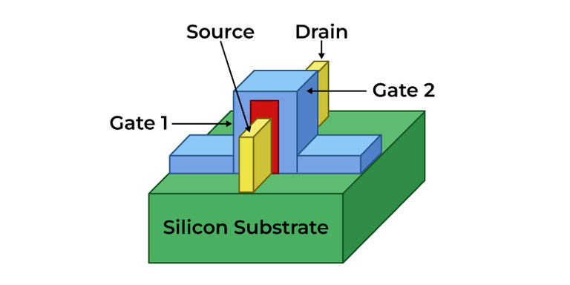
What is FinFET?
FinFET is a type of non-planar (3D) transistor used in modern semiconductor devices. It is named after the “fin”-like structure that rises above the substrate, which acts as the channel through which current flows.

Slide 4
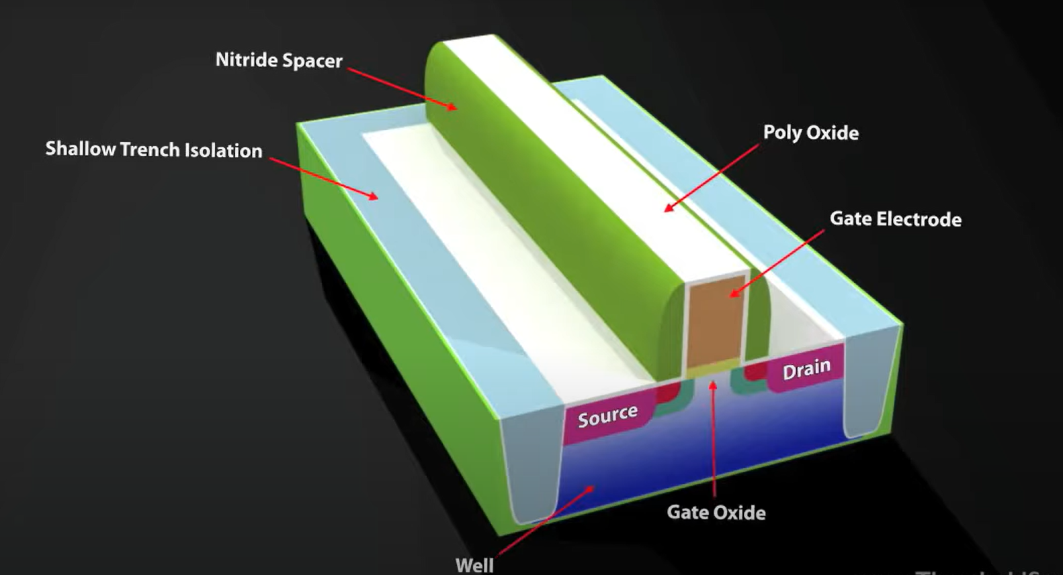

Slide 5
What is Adiabatic logic??
Adiabatic logic is a low-power digital circuit design technique where energy used to charge and discharge capacitors is partially recovered, rather than being dissipated as heat (as in conventional CMOS logic).
Key points:
Slow switching to reduce energy loss.
Reversible logic — circuit operations can be reversed.
Uses AC power clocks (often sinusoidal or trapezoidal).
Common styles: ECRL (Efficient Charge Recovery Logic), PFAL (Positive Feedback Adiabatic Logic).

Slide 6
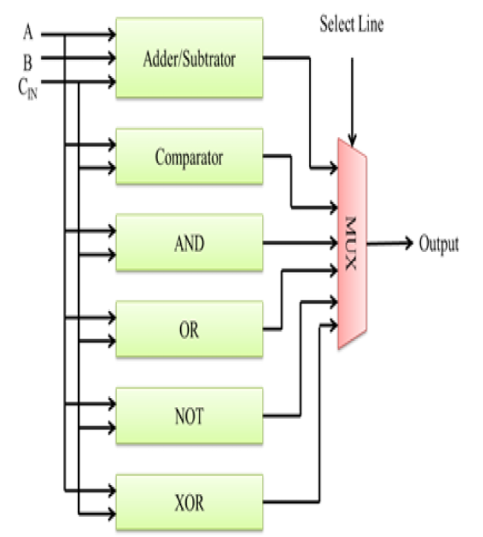
ALU Architecture
.

Slide 7

Why not CMOS??
🔹 High leakage power due to bulk cmos.
🔹 180nm is outdated.
🔹Dynamic power loss in switiching.
🔹 It requires large area due to planar CMOS.

Slide 8
Methodology
Identify the Problem
Select Suitable Technologies
Design the 4-bit ALU
Develop Adiabatic Logic Blocks
Implement with FinFET Devices
Simulation & Analysis

Slide 9


